Slide 1
MODULE 4
Register Transfer Language and Micro operations
Dr. Chhaya Suryabhan Dule
Associate Professor
School of CSE
Sapthagiri NPS University ,
BANGALORE

Slide 2
SYLLABUS
Register Transfer Language and Micro operations:
Register Transfer language—Register Transfer—Bus and memory transfers—Arithmetic Micro operations—logic micro-operations—shift micro-operations—Arithmetic logic shift unit.

Slide 3
REGISTER TRANSFER LANGUAGE
Digital systems are composed of modules that are constructed from digital components, such as
registers, decoders, arithmetic elements, and control logic.
The modules are interconnected with common data and control paths to form a digital computer system.
The operations executed on data stored in registers are called micro-operations.
A micro-operation is an elementary operation performed on the information stored in one or more registers.
Examples
shift
count
clear
load

Slide 4
REGISTER TRANSFER LANGUAGE
Some of the digital components are registers that implement micro operations.
The internal hardware organization of a digital computer is best defined by specifying.
The set of registers it contains and their functions
The sequence of micro-operations performed on the binary information stored
The control that initiates the sequence of micro-operations
Use symbols, rather than words, to specify the sequence of micro-operations.
The symbolic notation used is called a Register transfer language.
A programming language is a procedure for writing symbols to specify a given computational process.

Slide 5
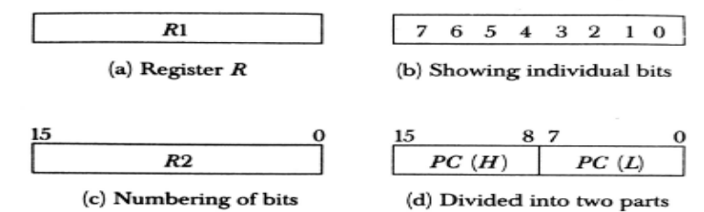
REGISTERS
MAR (Memory Address Register ) : Register that holds an address for memory unit
PC(Program Counter) : Holds the address of next instruction to be executed
IR(Instruction Register) : Executes the current instruction
PR(Processor Register R1….R6) : Temporarily holds the data
The individual flip-flops in an n-bit register are numbered in sequence from 0 to n-1.
Most common way to represent a register by a rectangular box with the name of register inside
The individual bits can be distinguished as in (b).
The numbering of bits in a 16-bit register can be marked on top of the box as shown in (c).
16-bit register is partitioned into two parts in (d).
Bits 0 through 7 are assigned the symbol L (for low byte) and
bits 8 through 15 are assigned the symbol H (for high byte).

Slide 6
REGISTER TRANSFER
Copying the content of one register to another register is a Register transfer
A Register Transfer is indicated as
R2 ← R1
Transfer the content of Register R1 into register R2
A Simultaneous transfer of all bits from source R1 to destination register R2 during one clock pulse .
Non-Destructive Transfer i.e content of R1 are not altered by copying (loading) to R2.

Slide 7
REGISTER TRANSFER
If we want the transfer to occur only under a predetermined control condition then it can be shown by an if-then statement.
If (P=1) then R2← R1
P is the control signal generated by a control section.
Every statement written in a register transfer notation implies a hardware construction for implementing the transfer.

Slide 8
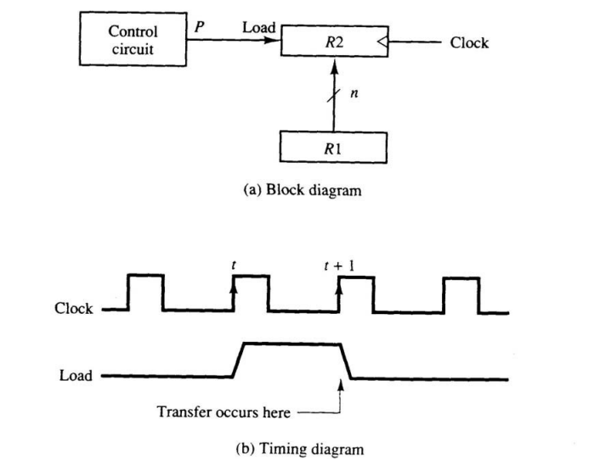
REGISTER TRANSFER
The n outputs of register R1 are connected to the n inputs of register R2.
The letter n will be used to indicate any number of bits for the register.
It will be replaced by an actual number when the length of the register is known.
Register R2 has a load input that is activated by the control variable P.
It is assumed that the control variable is synchronized with the same clock as the one applied to the register.
.

Slide 9
REGISTER TRANSFER
As shown in the timing diagram, P is activated in the control section by the rising edge of a clock pulse at time t.
The next positive transition of the clock at time t + 1 finds the load input active and the data inputs of R2 are then loaded into the register in parallel.
P may go back to 0 at time t+1; otherwise, the transfer will occur with every clock pulse transition while P remains active.
Even though the control condition such as P becomes active just after time t, the actual transfer does not occur until the register is triggered by the next positive transition of the clock at time t +1.

Slide 10
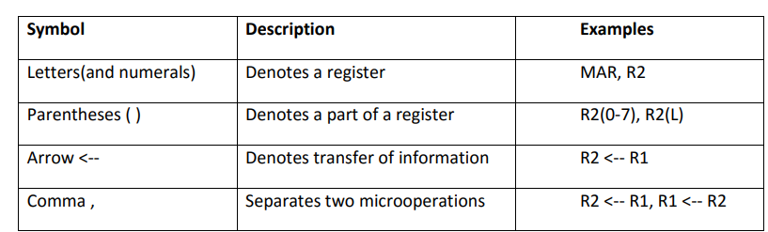
REGISTER TRANSFER
The basic symbols of the register transfer notation are listed
A comma is used to separate two or more operations that are executed at the same time.
All micro operations written on a single line are to be executed at the same time
T: R2 ← R1, R1 ←R2

Slide 11
BUS AND MEMORY TRANSFER
A more efficient scheme for transferring information between registers in a multiple-register configuration is a Common Bus System.
A common bus consists of a set of common lines, one for each bit of a register.
Control signals determine which register is selected by the bus during each particular register transfer.
Different ways of constructing a Common Bus System.
Using Multiplexers
Using Tri-state Buffers

Slide 12
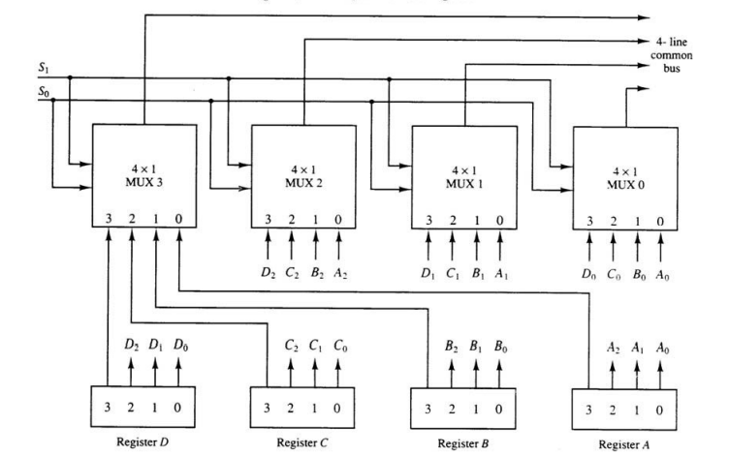
COMMON BUS SYSTEM IS WITH MULTIPLEXERS
A more efficient scheme for transferring information between registers in a multiple-register configuration is a Common Bus System.
The multiplexers select the source register whose binary information is then placed on the bus.
The construction of a bus system for four registers is shown below

Slide 13
COMMON BUS SYSTEM IS WITH MULTIPLEXERS
The bus consists of four 4 x 1 multiplexers each having four data inputs, 0 through 3, and two selection inputs, S1 and S0.
For example, output 1 of register A is connected to input 0 of MUX 1 because this input is labelled A1.
The diagram shows that the bits in the same significant position in each register are connected to the data inputs of one multiplexer to form one line of the bus.
Thus MUX 0 multiplexes the four 0 bits of the registers, MUX 1 multiplexes the four 1 bits of the registers, and similarly for the other two bits.

Slide 14
COMMON BUS SYSTEM IS WITH MULTIPLEXERS
The two selection lines S1 and So are connected to the selection inputs of all four multiplexers.
The selection lines choose the four bits of one register and transfer them into the four-line common bus.
When S1S0 = 00, the 0 data inputs of all four multiplexers are selected and applied to the outputs that form the bus.
This causes the bus lines to receive the content of register A since the outputs of this register are connected to the 0 data inputs of the multiplexers.
Similarly, register B is selected if S1S0 = 01, and so on.

Slide 15
COMMON BUS SYSTEM WITH MULTIPLEXERS
Table below shows the register that is selected by the bus for each of the four possible binary value of the selection lines.
In general, a bus system has
Multiplex “k” Registers
each register of “n” bits
no. of multiplexers required = n
S1 | S0 | Register Selected
0 | 0 | A
0 | 1 | B
1 | 0 | C
1 | 1 | D

Slide 16
COMMON BUS SYSTEM WITH MULTIPLEXERS
When the bus is includes in the statement, the register transfer is symbolized as follows:
BUS← C, R1← BUS
The content of register C is placed on the bus, and the content of the bus is loaded into register R1 by activating its load control input.
If the bus is known to exist in the system, it may be convenient just to show the direct transfer.
R1← C

Slide 17

THREE STATE BUS BUFFERS
Instead of Using multiplexers ,three state gates can be used to construct the bus system
A Three-State gate is a digital circuit that exhibits three states
Two of the states are signals equivalent to logic 1 and 0
The third state is a High-Impedance state – behaves like an open circuit ,which means the output is disconnected and does not have a logic significance
The graphic symbol of a three state buffer gate
.

Slide 18
THREE STATE BUS BUFFERS
The three-state buffer gate has a normal input and a control input which determines the output state.
With control 1, the output equals the normal input.
With control 0, the gate goes to a high-impedance state.
This enables a large number of three-state gate outputs to be connected with wires to form a common bus line without endangering loading effects.
.

Slide 19
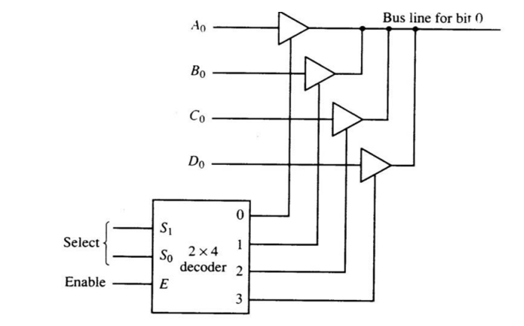
CONSTRUCTION OF A BUS SYSTEM WITH THREE_STATE BUFFERS
The outputs of four buffers are connected together to form a single bus line.
The control inputs to the buffers determine which of the four normal inputs will communicate with the bus line.
No more than one buffer may be in the active state at any given time. The connected buffers must be controlled so that only one three-state buffer has access to the bus line while all other buffers are maintained in a high impedance state.

Slide 20
CONSTRUCTION OF A BUS SYSTEM WITH THREE_STATE BUFFERS
One way to ensure that no more than one control input is active at any given time is to use a decoder, as shown in the diagram.
When the enable input of the decoder is 0, all of its four outputs are 0, and the bus line is in a high-impedance state because all four buffers are disabled.
When the enable input is active, one of the three-state buffers will be active, depending on the binary value in the select inputs of the decoder.

Slide 21
MEMORY TRANSFER
The transfer of information from a memory word to the outside environment is called a read operation.
The transfer of new information to be stored into the memory is called a write operation.
A memory word will be symbolized by the letter M.
It is necessary to specify the address of M when writing memory transfer operations.
Designate the address register by AR and the data register by DR.
The read operation can be stated as follows:
DR ← M[AR]
The write operation can be stated as:
Write: M[AR] ← R1
.

Slide 22
TYPES OF MICRO-OPERATIONS
Register Transfer Micro-operations: Transfer binary information from one register to another.
Arithmetic Micro-operations: Perform arithmetic operation on numeric data stored in registers.
Logical Micro-operations: Perform bit manipulation operations on data stored in registers.
Shift Micro-operations: Perform shift operations on data stored in registers.
Register Transfer Micro-operation : Doesn’t change the information content when the binary information moves from source register to destination register.
Other three types of micro-operations change the information content during the transfer.

Slide 23
ARITHMETIC MICRO-OPERATIONS
The basic arithmetic micro-operations are addition , subtraction , increment ,decrement and shift .
Arithmetic Micro-operations: Perform arithmetic operation on numeric data stored in registers.
Addition Micro-operations:
Example of addition : R3 ← R1 + R2

Slide 24
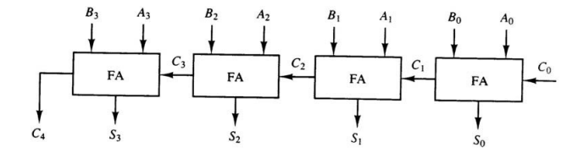
BINARY ADDER
A binary adder is a digital circuit that generates the arithmetic sum of two binary numbers of any length.
A binary added is constructed with full-adder circuits connected in cascade.
An n-bit binary adder requires n full-adders.
Fig : Interconnection of four full-adders (FA) to provide a 4-bit binary adder

Slide 25
BINARY ADDER
The augends bits of A and the addend bits of B are designated by subscript numbers from right to left, with subscript 0 denoting the low-order bit.
The carries are connected in a chain through the full-adders. The input carry to the binary adder is Co and the output carry is C4. The S outputs of the full-adders generate the required sum bits.
An n-bit binary adder requires n full-adders.
Fig : Interconnection of four full-adders (FA) to provide a 4-bit binary adder

Slide 26
SUBTRACTION OPERATIONS
Substraction Operations: Subtraction is most often implemented through complementation and addition.
-
Example of Subtraction : R3 ← R1 + R2+1
R2 - 1’s Complement
R2+1 - 2’s Complement
Adding the content of R1 to the 2’s complement of R2 is equivalent to Subtraction

Slide 27
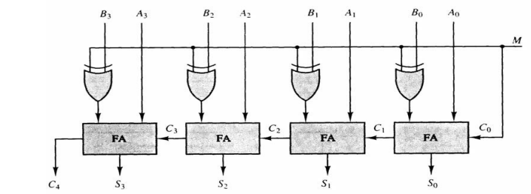
BINARY SUBTRACTOR
The mode input M controls the operation. When M = 0 the circuit is an adder and when M = 1 the circuit becomes a subtractor.
Each exclusive-OR gate receives input M and one of the inputs of B.
When M = 0, we have B XOR 0 = B. The full-adders receive the value of B, the input carry is 0, and the circuit performs A plus B.
Fig : 4-bit binary adder/Subtractor

Slide 28
BINARY SUBTRACTOR
When M = 1, we have B xor 1 = B' and Co = 1.
The B inputs are all complemented and a 1 is added through the input carry.
The circuit performs the operation A plus the 2's complement of B.
Fig : 4-bit binary adder/Subtractor

Slide 29
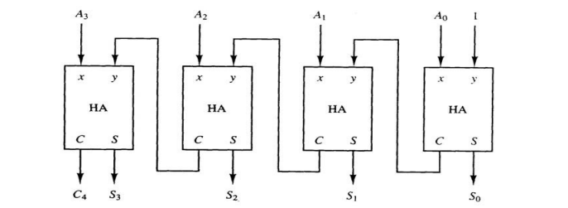
BINARY INCREMENTER
The increment microoperation adds one to a number in a register.
For example, if a 4-bit register has a binary value 0110, it will go to 0111 after it is incremented.
This can be implemented by using a binary counter – every time the count enable is active, the count is incremented by one.
If the increment is to be performed independent of a particular register, then use half-adders connected in cascade.
Fig : 4-bit binary incrementer

Slide 30
BINARY INCREMENTER
An n-bit binary incrementor requires n half-adders.
One of the inputs to the least significant half-adder (HA) is connected to logic-1 and the other input is connected to the least significant bit of the number to be incremented.
The output carry from one half-adder is connected to one of the inputs of the next-higher-order half-adder.
The circuit receives the four bits from A0 through A3, adds one to it, and generates the incremented output in S0 through S3.
Fig : 4-bit binary incrementer

Slide 31
BINARY INCREMENTER
The output carry C4 will be 1 only after incrementing binary 1111. This also causes outputs S0 through S3 to go to 0.
The circuit can be extended to an n -bit binary incrementer by extending the diagram to include n half-adders.
The least significant bit must have one input connected to logic-1. The other inputs receive the number to be incremented or the carry from the previous stage.
Fig : 4-bit binary incrementer

Slide 32
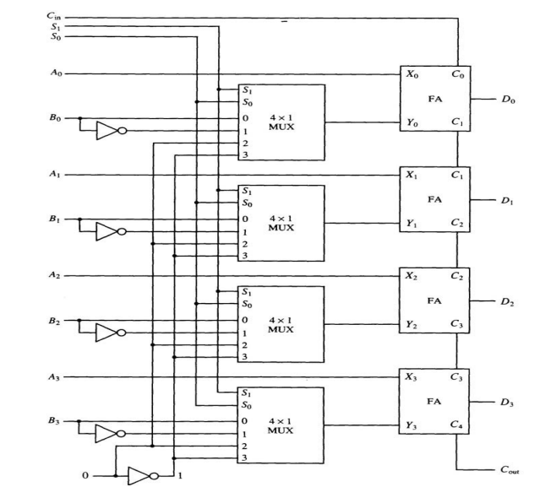
ARITHMETIC CIRCUIT
The basic component of an arithmetic circuit is the parallel adder.
By controlling the data inputs to the adder, it is possible to obtain different types of arithmetic operations.
The diagram of a 4-bit arithmetic circuit is consist of four full-adder circuits that constitute the 4-bit adder and four multiplexers for choosing different operations.
Fig : 4-bit Arithmetic circuit

Slide 33
ARITHMETIC CIRCUIT
There are two 4-bit inputs A and B and a 4-bit output D.
The four inputs from A go directly to the X inputs of the binary adder.
Each of the four inputs from B are connected to the data inputs of the multiplexers.
The multiplexers data inputs also receive the complement of B.
The other two data inputs are connected to logic-0 and logic-1.
Fig : 4-bit Arithmetic circuit

Slide 34
ARITHMETIC CIRCUIT
The four multiplexers are controlled by two selection inputs S1 and S0. The input carry Cin, goes to the carry input of the FA in the least significant position. The other carries are connected from one stage to the next.
By controlling the value of Y with the two selection inputs S1 and S0 and making Cin equal to 0 or 1, it is possible to generate the eight arithmetic microoperations
Fig : 4-bit Arithmetic circuit

Slide 35
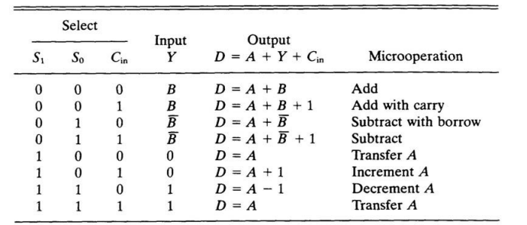
ARITHMETIC CIRCUIT
Fig : Arithmetic circuit Function Table

Slide 36
ARITHMETIC CIRCUIT
Addition:
When S1S0= 00, the value of B is applied to the Y inputs of the adder.
If Cir, = 0, the output D =A+B.
If Cin = 1, output D=A+B + 1.
Both cases perform the add microoperation with or without adding the input carry.
Fig : 4-bit Addition circuit

Slide 37
ARITHMETIC CIRCUIT
Subtraction:
When S1S0 = 01, the complement of B is applied to the Y inputs of the adder.
If Cin = 1, then D = A + B + 1. This produces A plus the 2's complement of B, which is equivalent to a subtraction of A -B.
When Cin = 0 then D = A + B. This is equivalent to a subtract with borrow, that is, A-B-1.
Fig : 4-bit Substraction circuit

Slide 38
ARITHMETIC CIRCUIT
Increment:
When S1S0 = 10, the inputs from B are neglected, and instead, all 0's are inserted into the Y inputs. The output becomes D = A + 0 + Cin.
This gives D = A when Cin = 0 and D = A + 1 when Cin = 1.
In the first case we have a direct transfer from input A to output D.
In the second case, the value of A is incremented by 1.
Fig : 4-bit Increment circuit

Slide 39
ARITHMETIC CIRCUIT
Decrement:
When S1S0= 11, all l's are inserted into the Y inputs of the adder to produce the decrement operation D = A -1 when Cin = 0.
This is because a number with all 1's is equal to the 2's complement of 1 (the 2's complement of binary 0001 is 1111). Adding a number A to the 2's complement of 1 produces F = A + 2's complement of 1 = A — 1. When Cin = 1, then D = A -1 + 1=A, which causes a direct transfer from input A to output D.
Fig : 4-bit Decrement circuit

Slide 40
LOGIC MICROOPERATIONS
Logic operations specify binary operations for strings of bits stored in registers and treat each bit separately.
Example: the XOR of R1 and R2 is symbolized by
P: R1 ← R1⊕ R2
It specifies a logic micro-operation to be executed on the individual bits of the registers provided that the control variable P = 1.

Slide 41
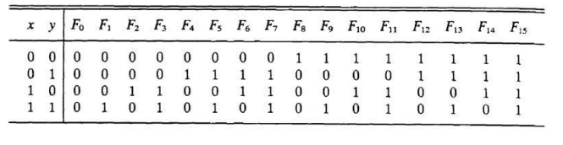
LIST OF LOGIC MICROOPERATIONS
There are 16 different logic operations that can be performed with two binary variables.
They can be determined from all possible truth tables obtained with two binary variables as Table below
The 16 Boolean functions of two variables x and y are expressed in algebraic form in the first column of Above
The 16 logic micro-operations are derived from these functions by replacing variable x by the binary content of register A and variable y by the binary content of register B.

Slide 42
LIST OF LOGIC MICROOPERATIONS
The logic micro-operations listed in the second column represent a relationship between the binary content of two registers A and B.
Example: R1 = 1010 and R2 = 1100
1010 Content of R1
1100 Content of R2
0110 Content of R1 after P = 1

Slide 43
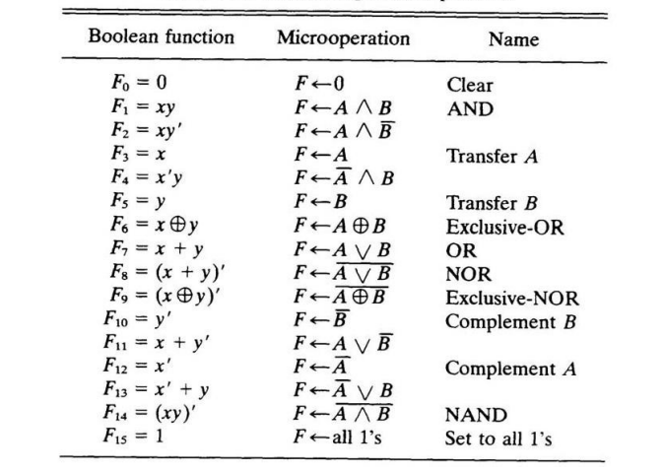
SYMBOLS USED FOR LOGICAL MICRO-OPERATIONS
OR:V
AND: ^
XOR: ⊕
The + sign has two different meanings: logical OR and summation
When + is in a micro-operation, then summation
When + is in a control function, then OR
P + Q: R1 ←R2 + R3, R4 ← R5 V R6
16 different logic operations performed with two binary variables.

Slide 44
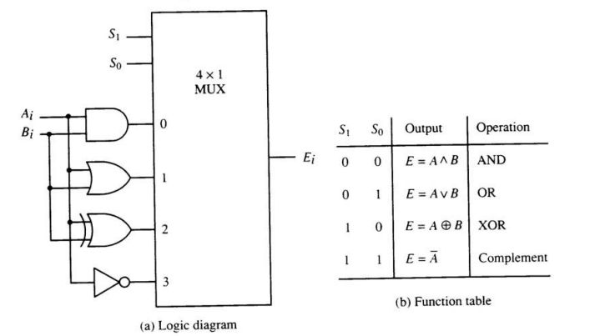
HARDWARE IMPLEMENTATION FOR LOGICAL MICRO-OPERATIONS
The hardware implementation of logic micro-operations requires that logic gates be inserted for each bit or pair of bits in the registers.
All 16 micro-operations can be derived from using four logic gates.
Figure shows one stage of a circuit that generates the four basic logic micro-operations.
It consists of four gates and a multiplexer. Each of the four logic operations is generated through a gate that performs the required logic.
The outputs of the gates are applied to the data inputs of the multiplexer. The two selection inputs S1 and S0 choose one of the data inputs of the multiplexer and direct its value to the output.

Slide 45
SOME APPLICATIONS
Logic micro-operations are very useful for manipulating individual bits or a portion of a word stored in a register.
They can be used to change bit values, delete a group of bits or insert new bits values into a register.
The following example shows how the bits of one register (designated by A) are manipulated by logic micro-operations as a function of the bits of another register (designated by B).

Slide 46
SELECTIVE SET
The selective-set operation sets to 1 the bits in register A where there are corresponding l's in register B. It does not affect bit positions that have 0's in B. The following numerical example clarifies this operation:
1010 A before
1100 B (Logic Operand)
1110 A after
The OR micro-operation can be used to selectively set bits of a register.

Slide 47
SELECTIVE COMPLEMENT
The selective-complement operation complements bits in A where there are corresponding 1’s in B .It does not affect bit positions that have 0’s in B .
1010 A before
1100 B (Logic Operand)
0110 A after
The exclusive-OR Micro-operation can be used to selectively complement bits of a register.

Slide 48
SELECTIVE CLEAR
The selective-clear operation clears to 0 to the bits in A only where there are corresponding 1’s in B.
1010 A before
1100 B (Logic Operand) 0010 A after
The corresponding logic micro-operation is A←Ā ^ B.

Slide 49
MASK
The mask operation is similar to the selective-clear operation except that the bits of A are cleared only where there is corresponding 0’s in B .The mask operation is an AND micro-operation as seen from the following example.
1010 A before
1100 B ( Mask)
1000 A After Masking

Slide 50
INSERT
The insert operation inserts a new value into a group of bits
This is done by first masking the bits to be replaced and then performing OR operation with the bits to be inserted
0110 1010 A before 0000 1010 A Before
0000 1111 B ( Mask) 1001 0000 B (insert)
0000 1010 A After Masking 1001 1010 A After Insertion
The mask operation is an AND micro-operation and insert operation is an OR micro-operation

Slide 51
CLEAR
The clear operation compares the bits in A and B and produces an all 0’s result if the two numbers are equal
1010 A
1010 B
0000 A A ← A Ꚛ B After Insertion

Slide 52
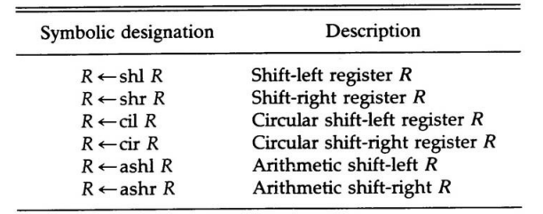
SHIFT MICROOPERATIONS
Shift micro-opeartions are used for serial transfer of data
They are also used in conjunction with arithmetic ,logic and other data processing operations
There are three type of shifts Logical ,circular and arithmetic

Slide 53
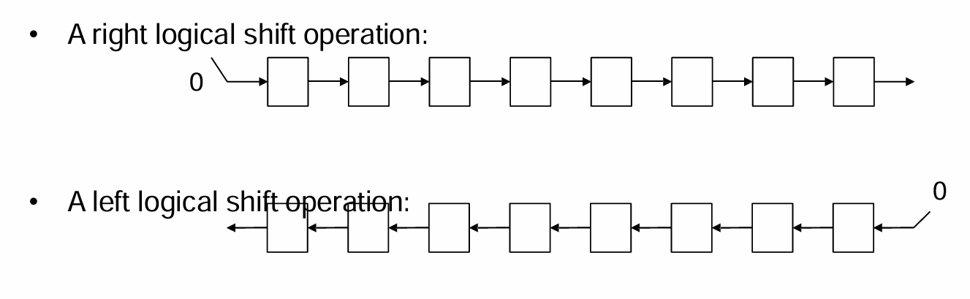
SHIFT MICROOPERATIONS
A Logical Shift is one that transfers 0 through the serial input .
The symbols shl and shr are for logical shift-left and shift-right by one position R1 ← shl R1.

Slide 54
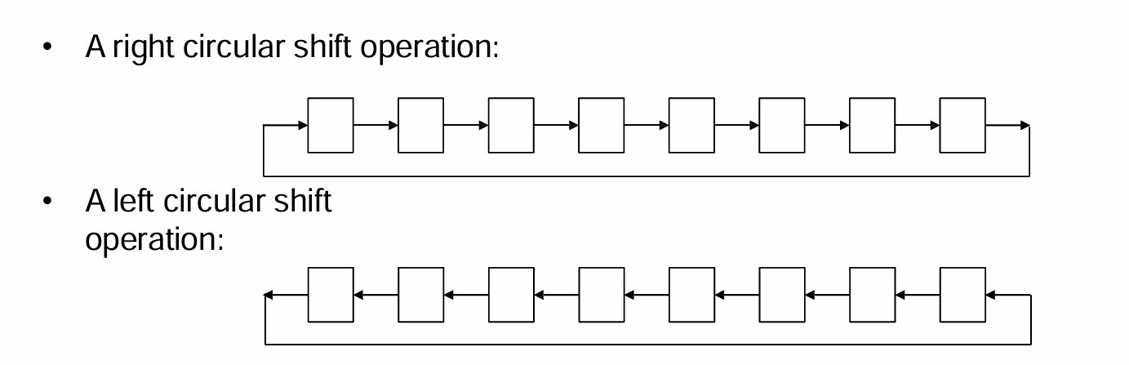
SHIFT MICROOPERATIONS
The A Circular Shift circulates the bits of the register around the two ends without loss of information .
The symbols cil and cir are for circular shift left and right

Slide 55

SHIFT MICROOPERATIONS
The arithmetic shift shifts a signed binary number to the left or right.
To the left is multiplying by 2, to the right is dividing by 2.
Arithmetic shifts must leave the sign bit unchanged.
A sign reversal occurs if the bit in Rn-1 changes in value after the shift.
This happens if the multiplication causes an overflow.
An overflow flip-flop Vs can be used to detect
The overflow Vs = Rn-1 ⊕Rn-2

Slide 56
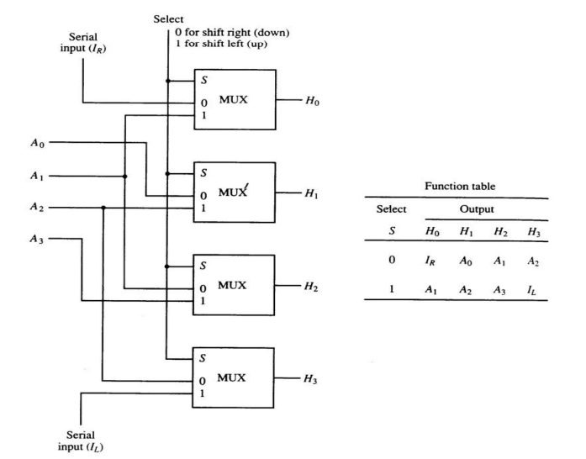
HARDWARE IMPLEMENTATION
The 4-bit shifter has four data inputs, A0 through A3, and four data outputs, H0 through H3.
There are two serial inputs, one for shift left (IL) and the other for shift right (IR).
When the selection input S=0 the input data are shifted right
When S = 1, the input data are shifted left.
The function table in Fig. 4-12 shows which input goes to each output after the shift.
A shifter with n data inputs and outputs requires n multiplexers.
The two serial inputs can be controlled by another multiplexer to provide the three possible types of shifts.

Slide 57
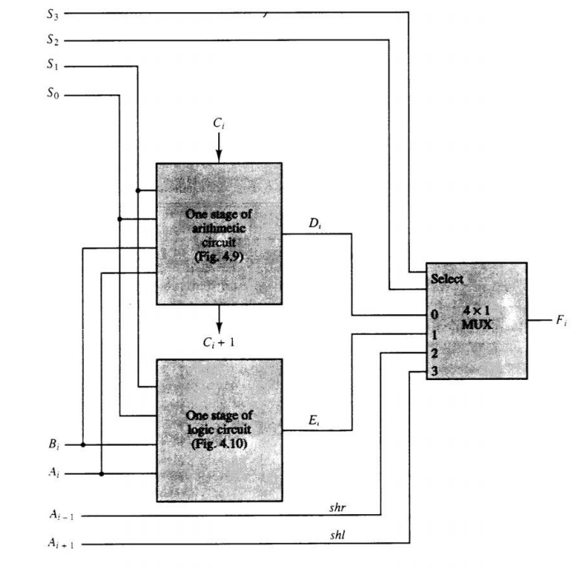
ARITHMETIC LOGIC SHIFT UNIT
The arithmetic logic unit (ALU) is a common operational unit connected to a number of storage registers.
To perform a microoperation, the contents of specified registers are placed in the inputs of the ALU.
The ALU performs an operation and the result is then transferred to a destination register.
The ALU is a combinational circuit so that the entire register transfer operation from the source registers through the ALU and into the destination register can be performed during one clock pulse period.

Slide 58
ARITHMETIC LOGIC SHIFT UNIT
The shift micro-operations are often performed in a separate unit, but sometimes the shift unit is made part of the overall ALU.
The arithmetic, logic, and shift circuits introduced in previous sections can be combined into one ALU with common selection variables. One stage of an arithmetic logic shift unit
Particular microoperation is selected with inputs S1 and S0. A 4 x 1 multiplexer at the output chooses between an arithmetic output in Di and a logic output in Ei.
The data in the multiplexer are selected with inputs S3 and S2. The other two data inputs to the multiplexer receive inputs Ai-1 for the shift-right operation and Ai+1 for the shift-left operation.

Slide 59
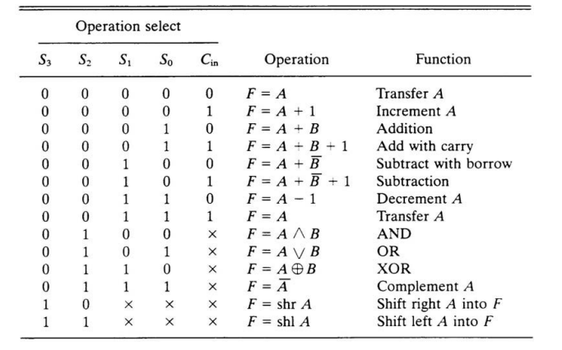
ARITHMETIC LOGIC SHIFT UNIT
The circuit whose one stage is specified in Figure provides eight arithmetic operation, four logic operations, and two shift operations.
Each operation is selected with the five variables S3, S2, S1, S0 and Cin.
The input carry Cin is used for selecting an arithmetic operation only
Table 4.7 lists the 14 operations of the ALU. The first eight are arithmetic operations and are selected with S3S2 = 00.
The next four are logic and are selected with S3S2 = 01.

Slide 60
ARITHMETIC LOGIC SHIFT UNIT
The input carry has no effect during the logic operations and is marked with don't-care x’s.
The last two operations are shift operations and are selected with S3S2= 10 and 11.
The other three selection inputs have no effect on the shift.

